Slide 1
Effective Communication Skills
A comprehensive guide to mastering communication in professional and personal life.

Slide 2

What is Communication?
Communication is the process of exchanging information, thoughts, and emotions through various means: - Verbal: Speaking in conversations, meetings, or phone calls. - Non-Verbal: Body language, facial expressions, and tone of voice. - Written: Emails, reports, and messages. - Visual: Charts, infographics, and videos.

Slide 3

Why is Communication Important?
- Builds strong relationships - Enhances teamwork and collaboration - Improves problem-solving skills - Boosts confidence and leadership abilities

Slide 4

Types of Communication
1. Verbal: Spoken words (face-to-face, phone calls, meetings) 2. Non-Verbal: Body language, facial expressions, gestures 3. Written: Emails, reports, social media 4. Visual: Graphs, charts, images, videos

Slide 5
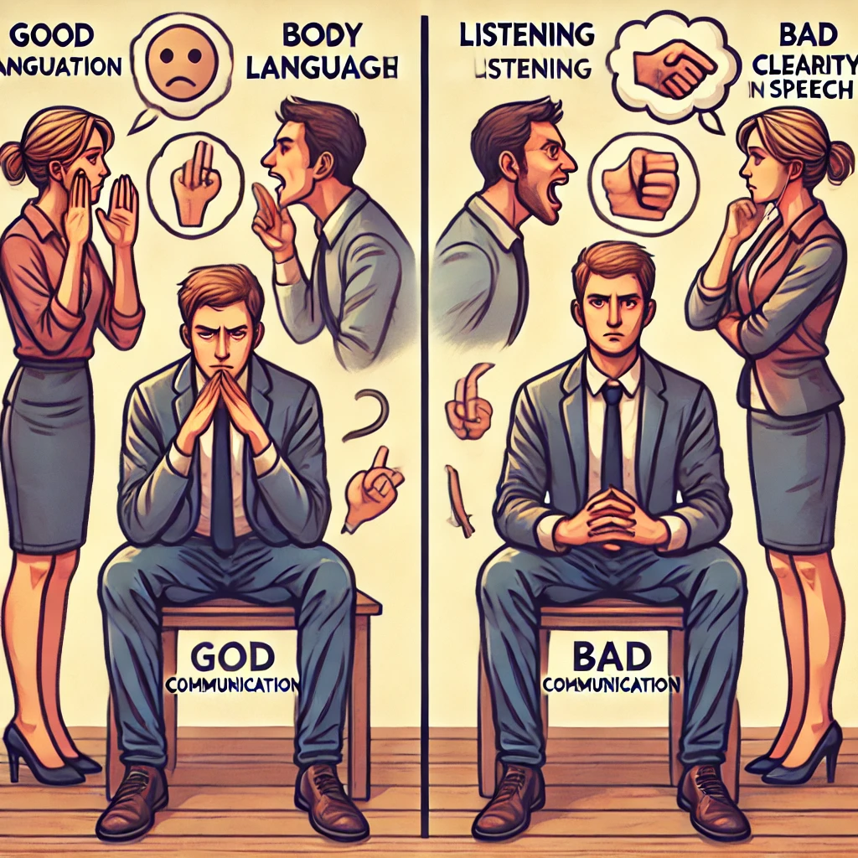
Good vs. Bad Communication
Good Communication: ✅ Clear and concise ✅ Active listening ✅ Open body language Bad Communication: ❌ Interrupting others ❌ Lack of clarity ❌ Negative body language

Slide 6
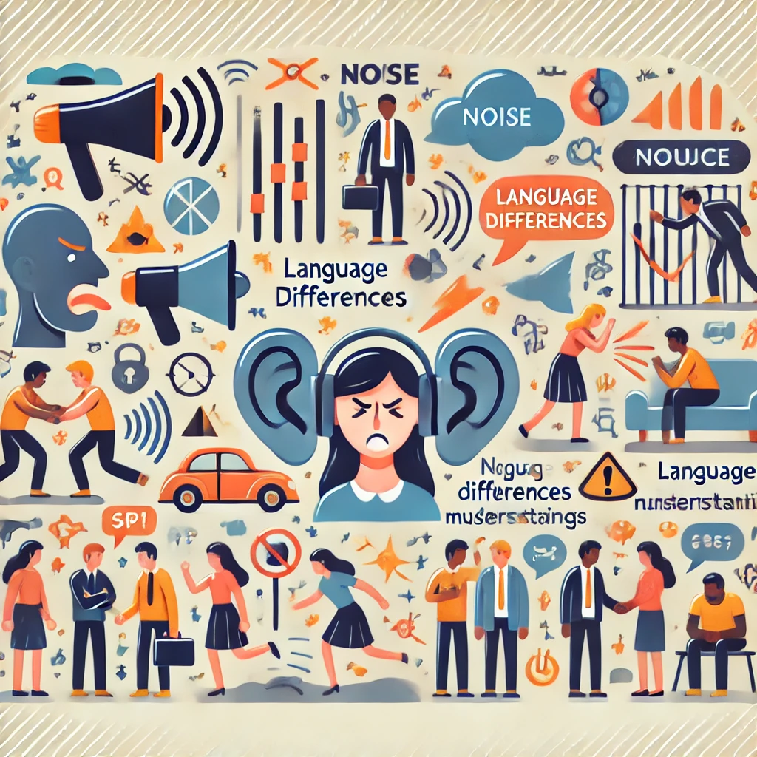
Common Barriers to Communication
- Language and cultural differences - Emotional barriers and fear - Noise and distractions - Lack of active listening

Slide 7
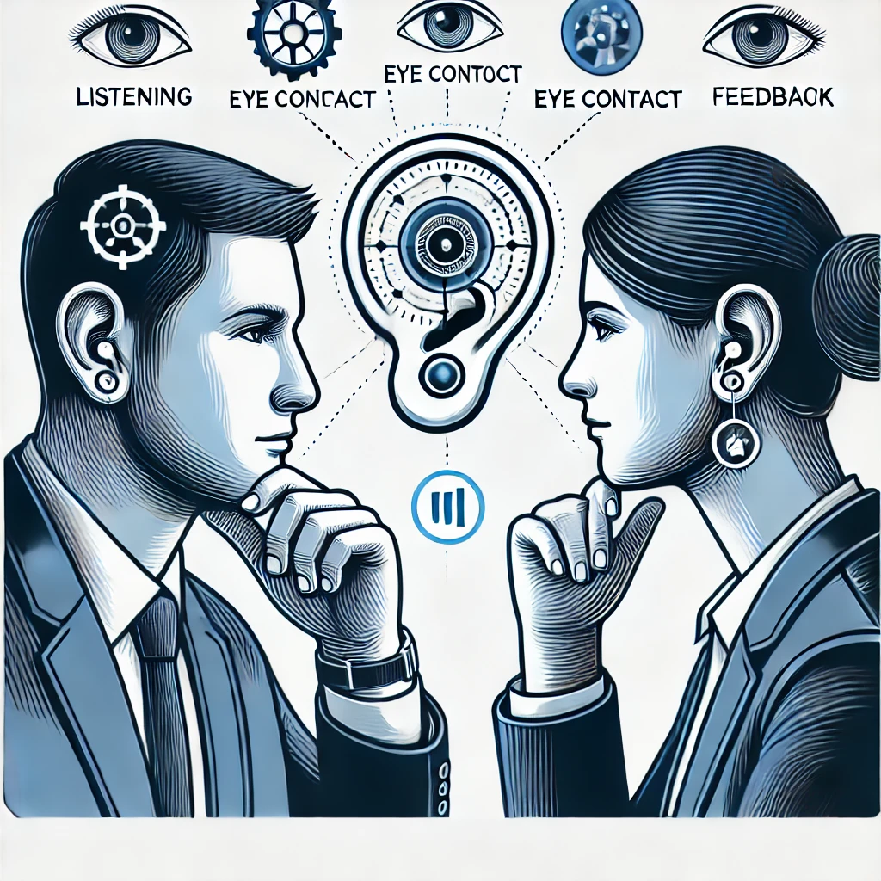
How to Improve Active Listening
- Pay full attention to the speaker - Show engagement through nodding and expressions - Avoid interrupting - Ask questions for clarity

Slide 8

Communication in the Workplace
- Use clear and professional language - Encourage open discussions - Provide constructive feedback - Adapt communication styles for different audiences

Slide 9
Communication for Leaders
- Inspire and motivate teams - Be transparent and approachable - Resolve conflicts effectively - Encourage a positive communication culture

Slide 10
Conclusion: Mastering Communication
Effective communication is essential for success in personal and professional life. Key Takeaways: ✅ Listen actively and attentively. ✅ Speak clearly and confidently. ✅ Use positive body language. ✅ Adapt your communication style based on your audience.

Slide 11
✅ Overcome barriers such as cultural differences, distractions, and misunderstandings. By improving your communication skills, you can foster stronger relationships, solve problems effectively, and become a great leader.

Slide 12
Final Thoughts on Communication
Effective communication is essential for success in personal and professional life. Key Takeaways: ✅ Listen actively and attentively. ✅ Speak clearly and confidently. ✅ Use positive body language. ✅ Adapt your communication style based on your audience. ✅ Overcome barriers such as cultural differences, distractions, and misunderstandings. By improving your communication skills, you can foster stronger relationships, solve problems effectively, and become a great leader.

